Slide 1
Reducing Child Labor Through Conditional Cash Transfers
Evidence from Nicaragua’s Red de Protección Social
Kevin A. Gee
Development Policy Review,2010
Presented by: Jiusi (Josie) Xiao

Slide 2
Introduction
Child Labor- persistent and widespread
Over 250 Million (Int’l Labor Org, 2006)
69% Child Labor in rural agricultural (Bhalotra and Heady,2003; ILO,2006)
Negative consequence- esp.on health and edu (Edmonds,2008)
Intervention in Latin America: Conditional Cash Transfer (CCT)
Incentive-based programs that provide eligible HH with periodic cash payments, conditional on children school attendance.

Slide 3
Background
CCT programs emerges during late 1990s
Earliest: Mexico’s Progresa (1997)
1st to explicitly offer impoverished rural HH cash subsidies
Honduras
Brazil
Nicaragua
Two interrelated mechanism
Cash subsidy: reduce direct cost and opportunity cost
Mandatory attendance for school

Slide 4
A review of 5 CCT pr0grams
Mexico’s Progresa
Parker and Skoufia (2000)
Examine: impact on probability and hours of working
Key Methodological strength: cluster randomized design
506 eligible communities randomly assigned to treatment (320) or control (186)
Finding:
Probability :
3.1% lower for Boy, age 8-17
1.2% lower for Girls, age 8-17
No impact on # of Hr. working

Slide 5
Brazil’s Bolsa Escola
Cardoso and Souza (2004)
Examine: probability and whether receipt of subsidy induces children to work while attending school
Method: Propensity score matching
Assign propensity score (based on background characteristics of children who receives the treatment)
Match based on propensity score→ treatment vs. control
Treatment = 80,400
Control = 37,700
Age 10-15

Slide 6
Brazil’s Bolsa Escola Cont.
Findings
Small but stat. significant reduction in probability
Boy 0.9% less
Girl 0.5% less
Bolsa Escola induces children to combine work and school, given they are already working
Higher probability to combine
Boy 0.5% more
Girl 0.9% more
CCT- effective to reduce child labor for children on the work/school margin, not influential for children who already works

Slide 7
Brazil’s PETI
Yap et al (2002)
Examine: probability of participation and impact on probability that children works 10+ hrs/ wk
Matching sampling procedure
HH data from 6 municipalities ( 3 treatment samples and 3 control groups)
Findings:
Treatment group display less probability of working, up to 26%
3.1-4.5% decrease in probability that children will work 10+ hrs
1-2 hr per week decrease in working hours

Slide 8
Honduras’ PRAF II
Olinto and de Souza (2005)
Examine only impact on probability of participation
Methodological strength: Cluster Randomized Design
Finding:
Small but stat. non-significant (1% decline) on probability for child labor (for children aged 6-16)
CCT, even though reduced prob., has no statistically significant impact→ contrasts with Progresa and PETI studies
Did NOT consider the children who are already working

Slide 9
Nicaragua’s RPS
Maluccio and Flores (2004)
Examine: impact on incidence of child labor
Cluster randomized design
Able to causally attribute any differences in probability of child labor between treatment and control groups
Findings:
Offer of RPS reduced child labor by 5%( for children aged 7-13 years )
But no report on average hrs of working for children who already works

Slide 10
Author’s critique
Mixed Evidence about impact on CCT offers
CCT → decline in Child labor
CCT→ no decline (not statistically significant) in Honduras PARF II
Possible: PARF II offer lowest amount of subsidy
Cluster randomized design vs. matching technique
Three uses cluster randomized design
Able to attribute declines in occurrence in child labor directly to CCT
Two uses Matching (Bosla Escola and PETI)
Non-randomized allocation→ limits causal attribution
Duration of child labor
Except for Progresa and PETI, none considered duration of child labor

Slide 11
Filling the Gap
Examine how a CCT offer impacts both probability of occurrence and duration of child labor
Reduce the probability that a child will work?
Reduce the number of hours a working child will engage in a work activities?
Nicaragua’s RPS
The only CCT in Latin America that utilized the random assignment
Able to compare its result to Progresa on impacts on both Prob. And duration

Slide 12
Research Site- Nicaragua
Child Labor often employed on tobacco, coffee, rice and banana plantation
17% children age 5-17 engaged in child labor (ILO,2003)
Red de Protección Social (RPS) implemented in 2000
Targets on low-income rural HH with children aged 7-13
Annual subsidy $112
Mandatory school enrollment and 85% attendance

Slide 13
Dataset
Red de Protección Social Evaluation Dataset,2000-2002 (RPSED)
Cluster-randomized experiment
42 eligible districts (21 control and 21 treatment)
Baseline data in 2000 and follow-up in 2001 & 2002
2002 data
1,397 HH (722 treatment and 675 control)
2,028 children aged 9-15 (979 from treatment and 1,049 from control)

Slide 14
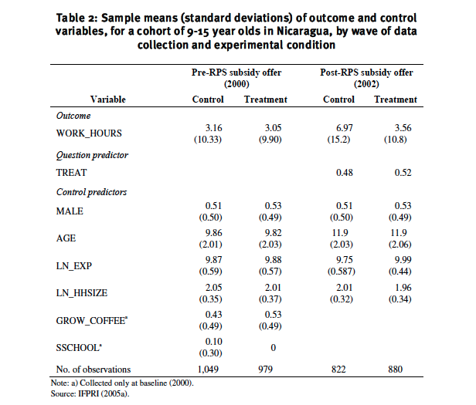
Sample Mean and Std Deviations

Slide 15
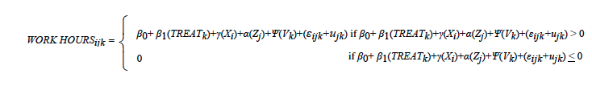
Theoretical Model- Tobit
for the i th child in the j th household from the k th district as follows, where Xi , Zj and Vk represent vectors of individual-, household-, and district-level covariates, respectively.
(εijk+ujk ) is a multilevel residual
Parameter β₁ represent both incidence and duration of child work (Decomposition method by McDonald and Moffit, 1980)

Slide 16
Findings
Estimated probability that a child will engage in work activities reduced by 10.6%t(p<0.001;α=0.05)
RPS offer reduces the hours of working, given the child is currently working, by approx. 3.65 hrs (p<0.001;α = 0.05)

Slide 17
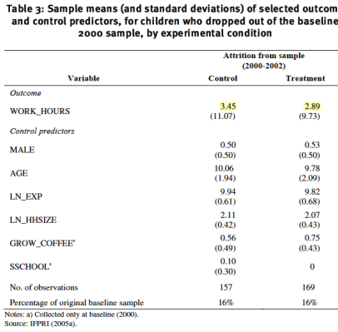
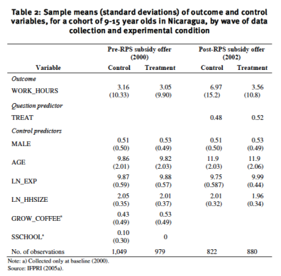
Threat to Validity Tests
Sample attrition (loss of participation)
16% of children from both treatment and control group are not included in 2002 wave

Slide 18
Threat to Validity Tests Cont.
Sensitivity analysis conducted for 326 children that were not present in 2002 wave
Carried forward their covariant value and refitted tobit in a larger sample of 2028 children
Robust to inclusion
Estimated probability that a child works reduced by 9.3% (compared to 10.6% in reduced sample)
Estimated duration reduced by 3.23hrs (compared to 3.65hrs )
Both effect stat. significant (p<0.001; α = 0.05)

Slide 19
Conclusion
Findings generally align with overall negative impacts of CCT on the incidents of child labor in Latin America
Stat. significant decline in probability (in contrast to Honduras PARF II)
Stat. significant reduction in work hours per week (in contrast to Mexico’s Progresa)
Explain the difference?
Different program design
Subsidy amount, requirement, eligible children etc

Slide 20
Conclusion Cont.
Brazil’s PETI
Strongest incentive against child labor→ largest amount of CCT
Mandatory after-school component → restrict hrs of work
Contractual requirement explicitly ban child labor
Mexico’s Progresa
Sliding subsidy scale→ adjust amount based in grade level enrolled
differentiate by gender→ girls receive higher amount
PARF II
Lowest amount of subsidy ($5/mo/enrolled child, 3 child max)

Slide 21
Conclusion Cont.
Possible explaination :Duration: RPS vs. Progresa
RPS targets children aged 7-14
Progresa included 14-18
It reached children who tended to have already dropped out in early grades and to be engaged in work prior to being offered CCT (Lloyd 2005)
Age 14-18 → more prone to drop out and continue to work
See summary table in paper for detailed comparison

Slide 22


Appendix: Decomposition Tobit
John F. McDonald and Rober A. Moffit (1980)
Tobit Model
The expected value of y is ,
And F(z) is normal cdf

Slide 23

Tobit Cont.
The expected value of y for observations above the limit, here called y*, is
Therefore, Ey = F(z) Ey*
Decomposition:
The total change in y can be disaggregated into two parts:
The change in y of those above the lim, weighted by the probability of being above the lim.
The change in probability of being above the lim, weighted by the expected value of y if above it

